Slide 1
BCSE309L – Cryptography and Network Security

Slide 2
Message Digest (MD5)

Slide 3
Message Digest (MD5)
MD5 was developed in 1991 by Ronald Rivest
MD5 is a cryptographic hash function algorithm that takes the message as input of any length and changes it into a fixed-length message of 16 bytes.
MD5 algorithm stands for the message-digest algorithm.
The output of MD5 (Digest size) is always 128 bits.
Plaintext = multiples of 512 bits
Message digest = 128 bits

Slide 4
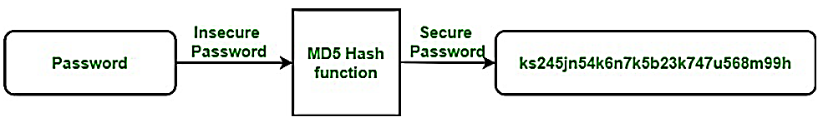
Message Digest (MD5)
Uses
  It is used for file authentication.
  In a web application, it is used for security purposes. e.g. Secure password of users etc.
  Using this algorithm, We can store our password in 128 bits format

Slide 5
Message Digest (MD5)
Working of MD5 Algorithm
  Append Padding Bits
  Append Length Bits
  Initialize MD buffer
  Process Each 512-bit Block

Slide 6
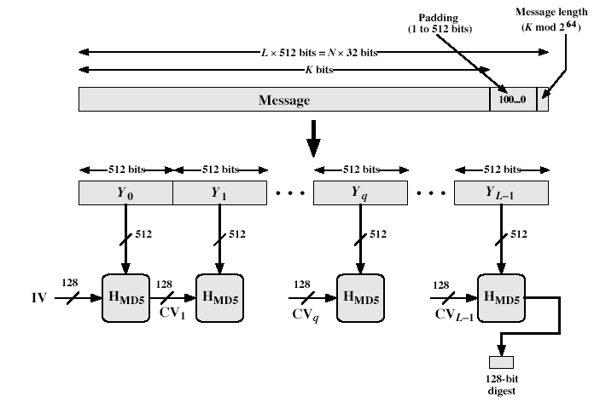
Message Digest (MD5)
L → No. of blocks

Slide 7
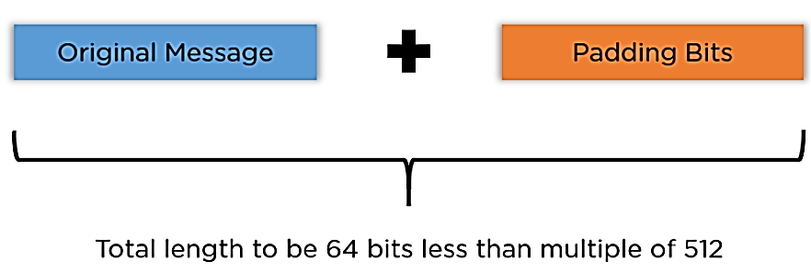
Message Digest (MD5)
  1. Append Padding Bits
  In the first step, we add padding bits in the original message in such a way that the total length of the message is 64 bits less than the exact multiple of 512
Length(original message + padding bits) = 512 * i – 64 where i = 1,2,3 . . .

Slide 8
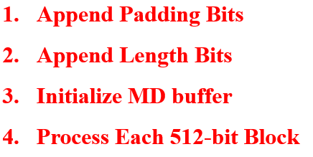
Message Digest (MD5)
Example:
Plaintext Message: “ They are deterministic”
  T → 54 → 01010100
  h → 68 → 01101000
  e → 65 → 01100101
  y → 79 → 01111001
  …
  01010100 01101000 01100101 01111001 00100000 01100001 01110010 01100101 00100000 01100100 01100101 01110100 01100101 01110010 01101101 01101001 01101110 01101001 01110011 01110100 01101001 01100011
  Total 22 letters including blank space → 22*8 = 176 bits
ASCII

Slide 9
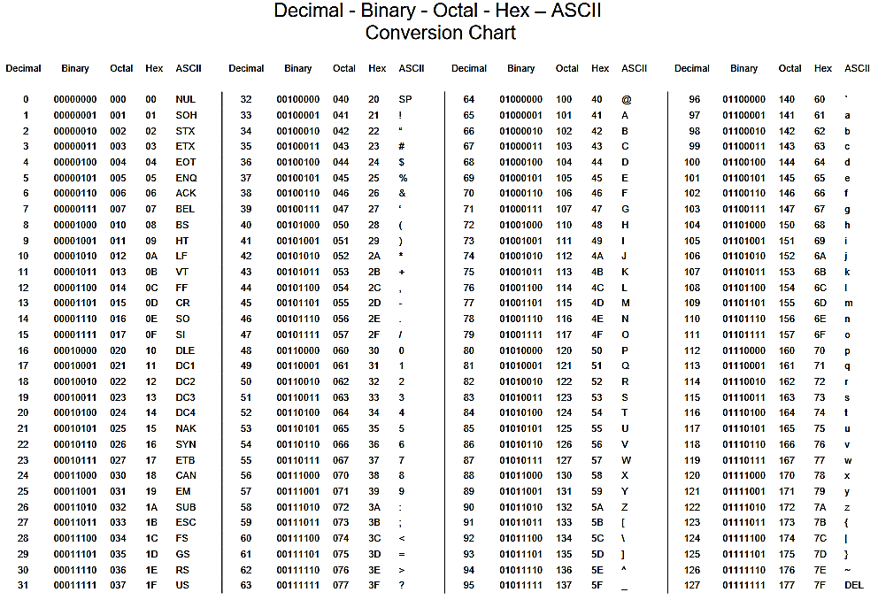


Slide 10
Message Digest (MD5)
SHA Method
176 + 64 = 240
512 – 240 = 272
Append Padding Bits
Length(original message + padding bits) = 512 * i – 64 where i = 1,2,3 . . .
= 512*1-64
= 512 – 64
= 448
Original message + padding = 448
176 + padding bits = 448
padding bits = 448-176
= 272 bits
= 1(1 bit) + 0 (271 bits)
01010100 01101000 01100101 01111001 00100000 01100001 01110010 01100101 00100000 01100100 01100101 01110100 01100101 01110010 01101101 01101001 01101110 01101001 01110011 01110100 01101001 01100011 10000000 00000000 00000000 00000000 00000000 00000000 00000000 00000000 00000000 00000000 00000000 00000000 00000000 00000000 00000000 00000000 00000000 00000000 00000000 00000000 00000000 00000000 00000000 00000000 00000000 00000000 00000000 00000000 00000000 00000000 00000000 00000000 00000000 00000000
272/8=34

Slide 11
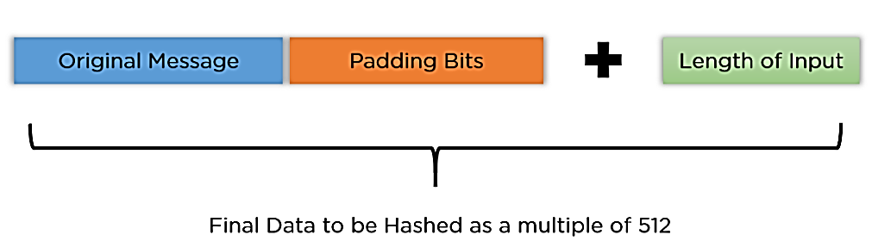
Message Digest (MD5)
  2. Append Length Bits
  Add length bit in the output of the first step in such a way that the total number of the bits is the perfect multiple of 512.
  Simply, here we add the 64-bit as a length bit in the output of the first step.
  i.e. output of first step = 512 * n – 64
  length bits = 64.
  After adding both, the length of the message = 512 * n

Slide 12
Message Digest (MD5)
Append Length Bits
01010100 01101000 01100101 01111001 00100000 01100001 01110010 01100101 00100000 01100100 01100101 01110100 01100101 01110010 01101101 01101001 01101110 01101001 01110011 01110100 01101001 01100011 10000000 00000000 00000000 00000000 00000000 00000000 00000000 00000000 00000000 00000000 00000000 00000000 00000000 00000000 00000000 00000000 00000000 00000000 00000000 00000000 00000000 00000000 00000000 00000000 00000000 00000000 00000000 00000000 00000000 00000000 00000000 00000000 00000000 00000000
Length of original message = 176 (Decimal)
= 10110000 (Binary)
This is the end of the padding scheme, while the preceding 56 bits are all filled up with zeros.
01010100 01101000 01100101 01111001 00100000 01100001 01110010 01100101 00100000 01100100 01100101 01110100 01100101 01110010 01101101 01101001 01101110 01101001 01110011 01110100 01101001 01100011 10000000 00000000 00000000 00000000 00000000 00000000 00000000 00000000 00000000 00000000 00000000 00000000 00000000 00000000 00000000 00000000 00000000 00000000 00000000 00000000 00000000 00000000 00000000 00000000 00000000 00000000 00000000 00000000 00000000 00000000 00000000 00000000 00000000 00000000
00000000 00000000 00000000 00000000 00000000 00000000 00000000 10110000

Slide 13
Message Digest (MD5)
  3. Initialize MD buffer (– to store output)
  Initialize four different buffers, namely A, B, C, and D.
  These buffers are 32 bits each and are initialized as follows:
A = 01 23 45 67
B = 89 ab cd ef
C = fe dc ba 98
D = 76 54 32 10
Each buffers= 32bits
Need 4 buffers (A, B, C, D) –
Store 32*4=128 bits

Slide 14
Message Digest (MD5)
  Length of message = 512 * n
4. Process each block:
    Each 512-bit block gets broken down further into 16 sub-blocks of 32 bits each.
    There are four rounds of operations, with each round utilizing all the 16 sub-blocks, the buffers, and a constant array value.
      This constant array can be denoted as K[1] → K[64].
      Each of the sub-blocks are denoted as M[0] → M[15]
Each block= 512 bits

Slide 15
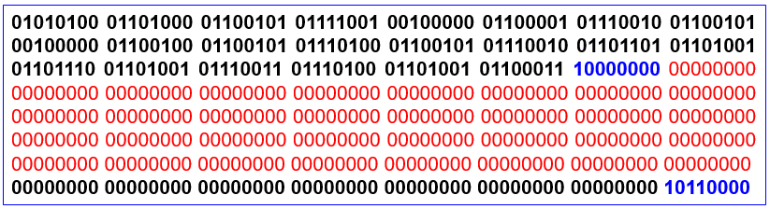
Message Digest (MD5)
512-bit M needs to be split into sixteen 32-bit “words”
M₀ – 01010100 01101000 01100101 01111001
M₁ – 00100000 01100001 01110010 01100101
M₂ – 00100000 01100100 01100101 01110100
M₃ – 01100101 01110010 01101101 01101001
M₄ – 01101110 01101001 01110011 01110100
M₅ – 01101001 01100011 10000000 00000000
M₆ – 00000000 00000000 00000000 00000000
M₇ – 00000000 00000000 00000000 00000000
M₈ – 00000000 00000000 00000000 00000000
M₉ – 00000000 00000000 00000000 00000000
M₁₀ – 00000000 00000000 00000000 00000000
M₁₁ – 00000000 00000000 00000000 00000000
M₁₂ – 00000000 00000000 00000000 00000000
M₁₃ – 00000000 00000000 00000000 00000000
M₁₄ – 00000000 00000000 00000000 00000000
M₁₅ – 00000000 00000000 00000000 10110000

Slide 16
Message Digest (MD5)
M₀ – 01010100 01101000 01100101 01111001 (Binary)
M₁ – 00100000 01100001 01110010 01100101
M₂ – 00100000 01100100 01100101 01110100
M₃ – 01100101 01110010 01101101 01101001
M₄ – 01101110 01101001 01110011 01110100
M₅ – 01101001 01100011 10000000 00000000
M₆ – 00000000 00000000 00000000 00000000
M₇ – 00000000 00000000 00000000 00000000
M₈ – 00000000 00000000 00000000 00000000
M₉ – 00000000 00000000 00000000 00000000
M₁₀ – 00000000 00000000 00000000 00000000
M₁₁ – 00000000 00000000 00000000 00000000
M₁₂ – 00000000 00000000 00000000 00000000
M₁₃ – 00000000 00000000 00000000 00000000
M₁₄ – 00000000 00000000 00000000 00000000
M₁₅ – 00000000 00000000 00000000 10110000
M₀ – 54686579 (Hex)
M₁ – 20617265
M₂ – 20646574
M₃ – 65726D69
M₄ – 6E697374
M₅ – 69638000
M₆ – 00000000
M₇ – 00000000
M₈ – 00000000
M₉ – 00000000
M₁₀ – 00000000
M₁₁ – 00000000
M₁₂ – 00000000
M₁₃ – 00000000
M₁₄ – 00000000
M₁₅ – 000000B0

Slide 17
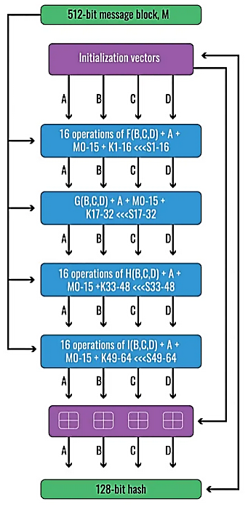
Message Digest (MD5)
Each of these M inputs (512 bits) are used in every single round, they are added in different orders.
In second round:
M1, M6, M11, M0, M5, M10, M15, M4, M9, M14, M3, M8, M13, M2, M7, M12
In third round
M5, M8, M11, M14, M1, M4, M7, M10, M13, M0, M3, M6, M9, M12, M15, M2
In fourth round
M0, M7, M14, M5, M12, M3, M10, M1, M8, M15, M6, M13, M4, M11, M2, M9

Slide 18
Message Digest (MD5)
Initialization vector
A – 01234567 (Hex)
B – 89abcdef
C – fedcba98
D – 76543210
M₀ – 54686579
M₁ – 20617265
M₂ – 20646574
M₃ – 65726D69
M₄ – 6E697374
M₅ – 69638000
M₆ – 00000000
M₇ – 00000000
M₈ – 00000000
M₉ – 00000000
M₁₀ – 00000000
M₁₁ – 00000000
M₁₂ – 00000000
M₁₃ – 00000000
M₁₄ – 00000000
M₁₅ – 000000B0

Slide 19
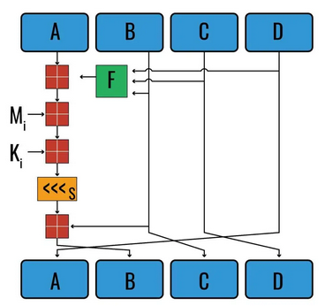
Message Digest (MD5)
Initialization vector
A – 01234567
B – 89abcdef
C – fedcba98
D – 76543210
M₀ – 54686579
M₁ – 20617265
M₂ – 20646574
M₃ – 65726D69
M₄ – 6E697374
M₅ – 69638000
M₆ – 00000000
M₇ – 00000000
M₈ – 00000000
M₉ – 00000000
M₁₀ – 00000000
M₁₁ – 00000000
M₁₂ – 00000000
M₁₃ – 00000000
M₁₄ – 00000000
M₁₅ – 000000B0

Slide 20

The values for K are is derived from the formula
K1 – D76AA478
K2 – E8C7B756
K3 – 242070DB
K4 – C1BDCEEE
K5 – F57COFA
K6 – 4787C62A
K7 – A8304613
K8 – FD469501
K9 – 698098D8
K10 – 8B44F7AF
K11 – FFFF5BB1
K12 – 895CD7BE
K13 – 6B901122
K14 – FD987193
K15 – A679438E
K16 – 49B40821
K17 – F61E2562
K18 – C040B340
K19 – 265E5A51
K20 – E9B6C7AA
K21 – D62F105D
K22 – 02441453
K23 – D8A1E681
K24 – E7D3FBC8
K25 – 21E1CDE6
K26 – C33707D6
K27 – F4D50D87
K28 – 455A14ED
K29 – A9E3E905
K30 – FCEFA3F8
K31 – 676F02D9
K32 – 8D2A4C8A
K33 – FFFA3942
K34 – 8771F681
K35 – 699D6122
K36 – FDE5380C
K37– A4BEEA44
K38 – 4BDECFA9
K39 – F6BB4B60
K40 – BEBFBC70
K41 – 289B7EC6
K42 – EAA127FA
K43 – D4EF3085
K44 – 04881D05
K45 – D9D4D039
K46 – E6DB99E5
K47 – 1FA27CF8
K48 – C4AC5665
K49 – F4292244
K50 – 432AFF97
K51 – AB9423A7
K52 – FC93A039
K53 – 655B59C3
K54 – 8F0CCC92
K55 – FFEFF47D
K56 – 85845DD1
K57 – 6FA87E4F
K58 – FE2CE6E0
K59 – A3014314
K60 – 4E0811A1
K61 – F7537E82
K62 – BD3AF235
K63 – 2AD7D2BB
K64 – EB86D391
Round1
Round2
Round3
Round4

Slide 21
Message Digest (MD5)
Each block → 4 rounds of operation
In each round → 16 operations are performed
  Total → 64 operations are performed in 4 rounds.
1st round → 16 operations will be performed
2nd round → 16 operations will be performed
3rd round → 16 operations will be performed
4th round → 16 operations will be performed.
We apply a different function on each round i.e. for the
  1st round, we apply the F function,
  2nd, we apply the G function
  3rd, we apply the H function
  4th, we apply the I function.

Slide 22
Message Digest (MD5)
Each round has 16 steps of the form:
  b = b+((a+f(b,c,d)+M[i]+K[i])<<<s)
g(b,c,d) is a different nonlinear function in each round (F,G,H,I)
Constant array : K[1] → K[64].
  K[1-16]
  K[17-32]
  K[33-48]
  K[49-64]
Each of the sub-blocks : M[0] → M[15]
  M[0] → 32bits
  M[1] → 32bits
  …
  M[15] → 32bits

Slide 23
Message Digest (MD5)
g(b,c,d) is a different nonlinear function in each round (F,G,H,I)
Perform OR, AND, XOR, and NOT (basically these are logic gates) for calculating functions
Use 3 buffers for each function
F(B,C,D) = (B AND C) OR (NOT B AND D)
G(B,C,D) = (B AND C) OR (C AND NOT D)
H(B,C,D) = B XOR C XOR D
I(B,C,D) = C XOR (B OR NOT D)

Slide 24
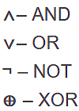
A – 01234567
B – 89abcdef
C – fedcba98
D – 76543210
The values for K are is derived from the formula
K1 – D76AA478
K2 – E8C7B756
K3 – 242070DB
K4 – C1BDCEEE
K5 – F57COFA
K6 – 4787C62A
K7 – A8304613
K8 – FD469501
K9 – 698098D8
K10 – 8B44F7AF
K11 – FFFF5BB1
K12 – 895CD7BE
K13 – 6B901122
K14 – FD987193
K15 – A679438E
K16 – 49B40821
K17 – F61E2562
K18 – C040B340
K19 – 265E5A51
K20 – E9B6C7AA
K21 – D62F105D
K22 – 02441453
K23 – D8A1E681
K24 – E7D3FBC8
K25 – 21E1CDE6
K26 – C33707D6
K27 – F4D50D87
K28 – 455A14ED
K29 – A9E3E905
K30 – FCEFA3F8
K31 – 676F02D9
K32 – 8D2A4C8A
K33 – FFFA3942
K34 – 8771F681
K35 – 699D6122
K36 – FDE5380C
K37– A4BEEA44
K38 – 4BDECFA9
K39 – F6BB4B60
K40 – BEBFBC70
K41 – 289B7EC6
K42 – EAA127FA
K43 – D4EF3085
K44 – 04881D05
K45 – D9D4D039
K46 – E6DB99E5
K47 – 1FA27CF8
K48 – C4AC5665
MD5 F, G, H and I functions
K49 – F4292244
K50 – 432AFF97
K51 – AB9423A7
K52 – FC93A039
K53 – 655B59C3
K54 – 8F0CCC92
K55 – FFEFF47D
K56 – 85845DD1
K57 – 6FA87E4F
K58 – FE2CE6E0
K59 – A3014314
K60 – 4E0811A1
K61 – F7537E82
K62 – BD3AF235
K63 – 2AD7D2BB
K64 – EB86D391
F(B, C, D) = (B∧C)∨(¬B∧D)
G(B, C, D) = (B∧D)∨(C∧¬D)
H(B, C, D) =B⊕C⊕D
I(B, C, D) = C⊕(B∨¬D)
M₀ – 54686579
M₁ – 20617265
M₂ – 20646574
M₃ – 65726D69
M₄ – 6E697374
M₅ – 69638000
M₆ – 00000000
M₇ – 00000000
M₈ – 00000000
M₉ – 00000000
M₁₀ – 00000000
M₁₁ – 00000000
M₁₂ – 00000000
M₁₃ – 00000000
M₁₄ – 00000000
M₁₅ – 000000B0
Round1
Round2
Round3
Round4

Slide 25

MD5 F, G, H and I functions
F(B, C, D) = (B∧C)∨(¬B∧D)
G(B, C, D) = (B∧D)∨(C∧¬D)
H(B, C, D) =B⊕C⊕D
I(B, C, D) = C⊕(B∨¬D)
F (89abcdef, fedcba98, 76543210) = (89abcdef AND fedcba98) OR (NOT-89abcdef AND 76543210)
F(B, C, D) = 88888888 OR 76543210
= fedcba98
Modular Addition → (X + Y) mod Z
X→01234567 (A)
Y→fedcba98 (Output of F)
Z→100000000 (2³²)
(X + Y) mod Z
= (01234567 + fedcba98) mod 100000000
= ffffffff mod 100000000
= ffffffff

Slide 26
MD5 F, G, H and I functions
F(B, C, D) = (B∧C)∨(¬B∧D)
G(B, C, D) = (B∧D)∨(C∧¬D)
H(B, C, D) =B⊕C⊕D
I(B, C, D) = C⊕(B∨¬D)
F (89abcdef, fedcba98, 76543210) = (89abcdef AND fedcba98) OR (NOT-89abcdef AND 76543210)
F(B, C, D) = 88888888 OR 76543210
= fedcba98
Modular Addition → ffffffff
(X + Y) mod Z
X → 54686579 (M0)
Y→ ffffffff (output of previous step)
Z→100000000 (2³²)
(X + Y) mod Z
= (54686579 + ffffffff) mod 100000000
= 154686578

Slide 27
MD5 F, G, H and I functions
F(B, C, D) = (B∧C)∨(¬B∧D)
G(B, C, D) = (B∧D)∨(C∧¬D)
H(B, C, D) =B⊕C⊕D
I(B, C, D) = C⊕(B∨¬D)
F (89abcdef, fedcba98, 76543210) = (89abcdef AND fedcba98) OR (NOT-89abcdef AND 76543210)
F(B, C, D) = 88888888 OR 76543210
= fedcba98
Modular Addition → 154686578
(X + Y) mod Z
X → d76aa478 (K1)
Y→ 154686578 (output of previous step)
Z→100000000 (2³²)
(X + Y) mod Z
= (d76aa478 + 54686578) mod 100000000
= 2bd309f0

Slide 28
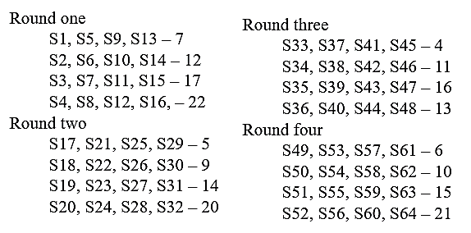
MD5 F, G, H and I functions
F(B, C, D) = (B∧C)∨(¬B∧D)
G(B, C, D) = (B∧D)∨(C∧¬D)
H(B, C, D) =B⊕C⊕D
I(B, C, D) = C⊕(B∨¬D)
F (89abcdef, fedcba98, 76543210) = (89abcdef AND fedcba98) OR (NOT-89abcdef AND 76543210)
F(B, C, D) = 88888888 OR 76543210
= fedcba98
Modular Addition → 2bd309f0
0010 1011 1101 0011 0000 1001 1111 0000
Left bit shift

Slide 29
A – 01234567
B – 89abcdef
C – fedcba98
D – 76543210
2bd309f0
001 0101 1110 1001 1000 0100 1111 1000 0xxx xxxx
Shift 7 bits left
1110 1001 1000 0100 1111 1000 0001 0101
In hexa
e984f815
(X + Y) mod Z
X → 89abcdef (B)
Y→ e984f815 (output of shift operation)
Z→100000000 (2³²)
(X + Y) mod Z
= (89abcdef + e984f895) mod 100000000
= 7330C604
First operation in Round1 is completed
A – 76543210
B – 7330c604
C – 89abcdef
D – fedcba98
Similarly do other 63 operations and generate the final Message Digest of 128 bits

